Slide 1
Filter()method
The filter() method creates a new array filled with elements that pass a test provided by a function.
The filter() method does not execute the function for empty elements.
The filter() method does not change the original array.

Slide 2
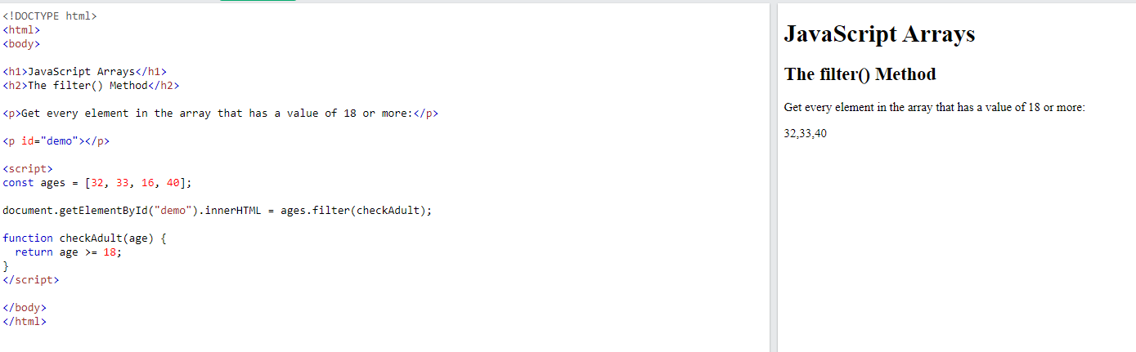

Slide 3
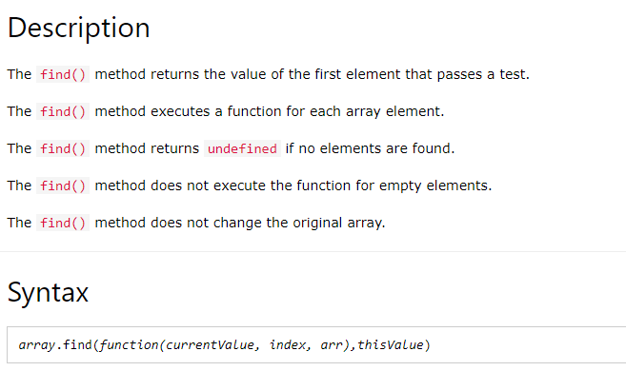
Find()

Slide 4
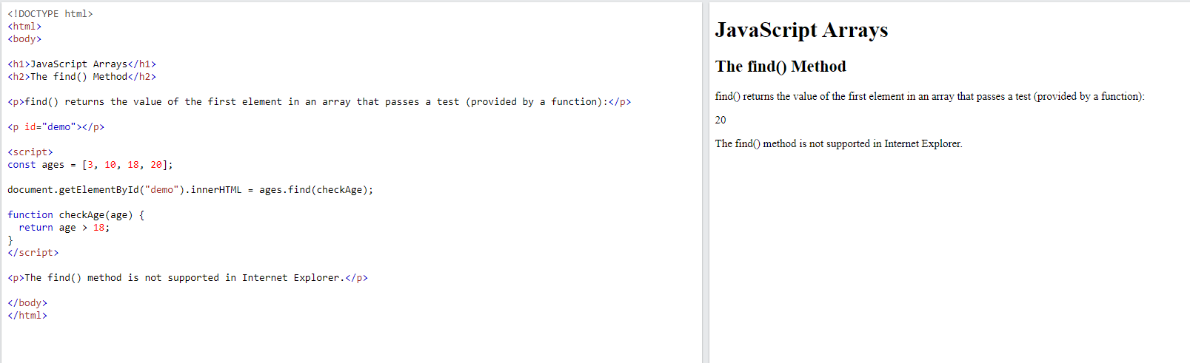

Slide 5
What is remove () in JavaScript?
The remove() method removes an element (or node) from the document.
use the methods like remove() and removeChild() in JavaScript to delete the elements from the document.

Slide 6
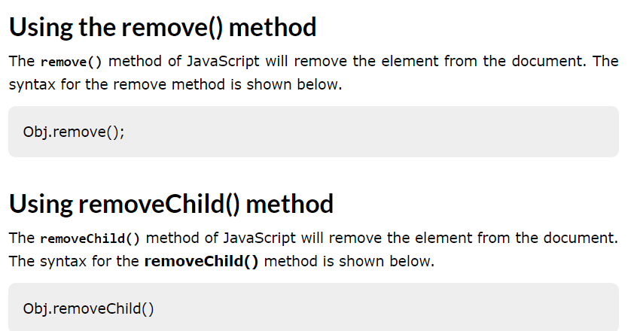

Slide 7
Map()
map() creates a new array from calling a function for every array element.
map() does not execute the function for empty elements.
map() does not change the original array.
Syntax
array.map(function(currentValue, index, arr), thisValue)

Slide 8
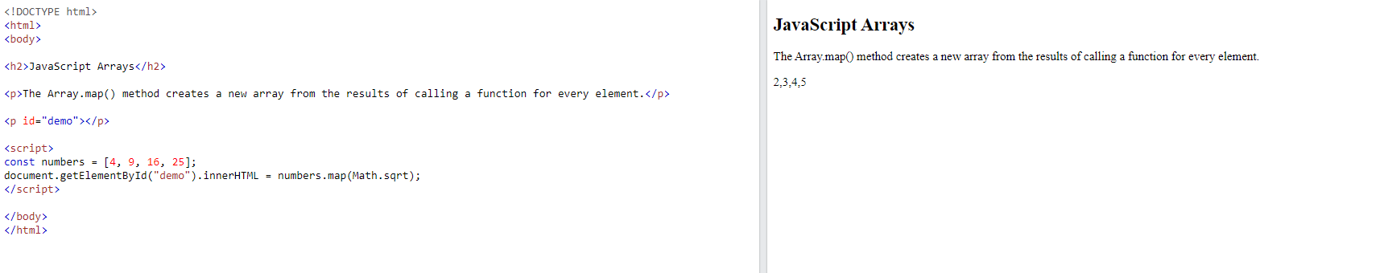

Slide 9
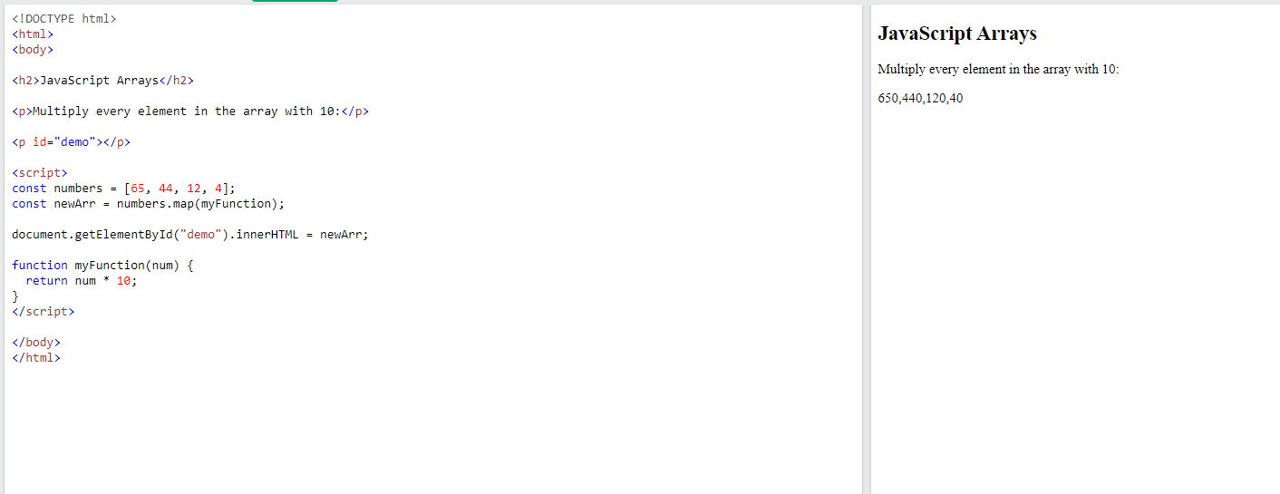

Slide 10
References: https://www.w3schools.com/
Thank you

